Slide 1

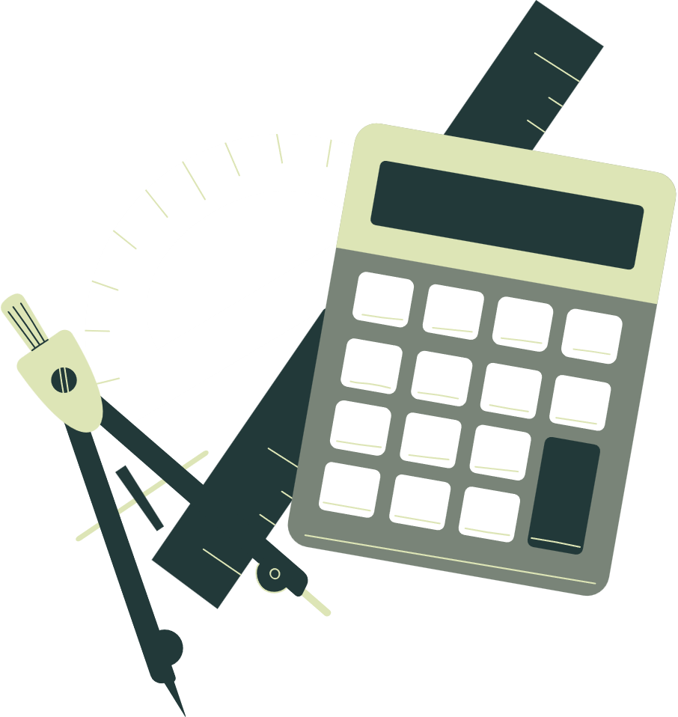

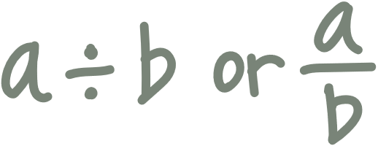


Review Session in
MATHEMATICS
MATHEMATICS
JERRY BOY D. ANDEZA JR., LPT
Faculty of Accountancy, Business, and Management
Culiat High School

Slide 2
GENERAL/BUSINESS
GENERAL/BUSINESS
MATH
MATH

Slide 3



HOW ARE YOU FEELING RIGHT NOW?

Slide 4

WHO AMONG OF YOU WANTS MONEY?

Slide 5

Review Question #1
Julianne needs Php 57,300.00 to buy cooking equipment for her new house. She is willing to pay the interest of Php 7,735.50 if she borrows the said amount from the bank. If she intends to pay her obligation within 30 months, what must be the interest rate of her loan?
A. 5.4%
C. 6.4%
B. 4.4%
D. 3.4%

Slide 6
Review Question #1
Julianne needs Php 57,300.00 to buy cooking equipment for her new house. She is willing to pay the interest of Php 7,735.50 if she borrows the said amount from the bank. If she intends to pay her obligation within 30 months, what must be the interest rate of her loan?
A. 5.4%
C. 6.4%
B. 4.4%
D. 3.4%

Slide 7
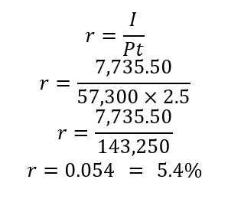

Review Question #1
Solution: In determining the interest rate of the loan, substitute the given:
Given:
Principal (P) = Php 57,300
Interest (I) = Php 7,735.50
Time (t) = 30 months = 2.5 years
Rate (r) = ?
Solve for the interest rate (r):
Formula: $I=Prt$
Answer:
The interest rate of the loan is 5.4% per annum.

Slide 8
Review Question #2
Sophia borrowed Php 25,000.00 from a lending corporation that charges 12% interest with an agreement to pay the principal and the interest at the end of the term. If she paid Php 35,000.00 at the end of the term, for how long did she use the money?
A. 2.5 years
C. 4.5 years
B. 3.5 years
%
D. 5.5 years

Slide 9
Review Question #2
Sophia borrowed Php 25,000.00 from a lending corporation that charges 12% interest with an agreement to pay the principal and the interest at the end of the term. If she paid Php 35,000.00 at the end of the term, for how long did she use the money?
A. 2.5 years
C. 4.5 years
B. 3.5 years
%
D. 5.5 years

Slide 10
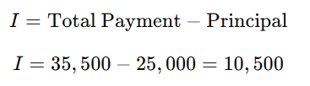
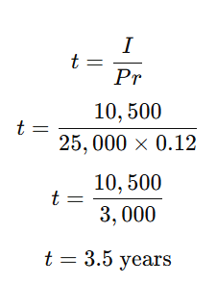

Review Question #2
Solution: In determining the interest rate of the loan, substitute the given:
Given:
Principal (P) = Php 25,000
Interest (I) = Php 10,000
Total amount paid = Php 35,500
Formula: $I=Prt$
Step 1: Solve for the interest paid
Step 2: Solve for time
Answer:
Therefore, Sophia used money for 3.5 years or 3 yrs. and 6mos.

Slide 11
Review Question #3
How much will be invested to accumulate Php 87,000 at the end of 6 years if money earns 9% interest rate, compounded quarterly?
A. Php 51,006.46
C. Php 51,004.46
B. Php 51,005.46
%
D. Php 51,003.46

Slide 12
Review Question #3
How much will be invested to accumulate Php 87,000 at the end of 6 years if money earns 9% interest rate, compounded quarterly?
A. Php 51,006.46
C. Php 51,004.46
B. Php 51,005.46
%
D. Php 51,003.46

Slide 13
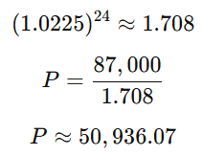
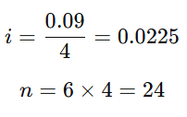
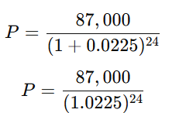

Review Question #3
Solution:
Given:
Future Value (F) = Php 87,000
Annual interest rate = 9% = 0.09
Compounded quarterly → 4 times per year
Time = 6 years
Step 1: Determine periodic rate and total periods
Step 2: Substitute into formula
Step 3: Compute

Slide 14
Review Question #4
In a convenient store, the manager was able to sell Php 27,500.00 worth of ice cream, Php 17,500.00 worth of coffee, and Php 8,500.00 worth of cookies. Which statement is based on the data presented?
A. Total sales are at most Php 50,000.00
B. Cookies are priced 50% cheaper than coffee
%
C. Coffee are 36% cheaper than ice cream
%
D. Sales for ice cream is at least 50% of the total sales
%

Slide 15
Review Question #4
In a convenient store, the manager was able to sell Php 27,500.00 worth of ice cream, Php 17,500.00 worth of coffee, and Php 8,500.00 worth of cookies. Which statement is based on the data presented?
A. Total sales are at most Php 50,000.00
B. Cookies are priced 50% cheaper than coffee
%
C. Coffee are 36% cheaper than ice cream
%
D. Sales for ice cream is at least 50% of the total sales
%

Slide 16
Review Question #4
Correct answer: D. Sales for ice cream is at least 50% of the total sales
Total sales are at most Php 50,000.00 ❌
Total sales = 27,500 + 17,500 + 8,500 = Php 53,500.00, which is more than Php 50,000.00.
B. Cookies are priced 50% cheaper than coffee ❌ The data only shows sales amounts, not prices. We cannot conclude anything about pricing.

Slide 17
Review Question #4
C. Coffee are 36% cheaper than ice cream ❌ Again, this compares sales values, not prices. “Cheaper” refers to price, which is not given, so this statement is unsupported.
D. Sales for ice cream is at least 50% of the total sales ✅ Ice cream sales = Php 27,500 Total sales = Php 53,500
Since this is greater than 50%, the statement is correct.
✅ Final Answer: D

Slide 18
Review Question #5
Which is the MOST likely explanation why the same investment will yield a bigger interest in one of the investment schemes?
Investment Scheme | Nominal Rate | Frequency of Compound | Interest Rate per conversion
I | 16% | quarterly | A
II | 16% | monthly | B
III | 16% | Semi-annually | C
A. More investments were placed
C. More compounding of interest in a year was done
B. A higher nominal rate was applaud
%
D. A higher interest rate per compoundingperiod was applied

Slide 19
Review Question #5
Which is the MOST likely explanation why the same investment will yield a bigger interest in one of the investment schemes?
Investment Scheme | Nominal Rate | Frequency of Compound | Interest Rate per conversion
I | 16% | quarterly | A
II | 16% | monthly | B
III | 16% | Semi-annually | C
A. More investments were placed
C. More compounding of interest in a year was done
B. A higher nominal rate was applaud
%
D. A higher interest rate per compoundingperiod was applied

Slide 20
Review Question #5
Correct answer: C. More compounding of interest in a year was done
More investments were placed ❌ This is incorrect. The problem states the same investment is used in all schemes. The difference in returns is not due to investing more money or making additional deposits.
B. A higher nominal rate was applied ❌ This is incorrect because the table shows that all three schemes have the same nominal rate of 16%. The nominal rate does not change between schemes.

Slide 21
Review Question #5
Correct answer: C. More compounding of interest in a year was done
C. More compounding of interest in a year was done ✅ (Correct) This is the main reason. Even though the nominal rate is the same, monthly compounding occurs more frequently than quarterly, which occurs more frequently than semi-annual compounding. More frequent compounding increases the effective annual interest, resulting in higher total interest earned.
D. A higher interest rate per compounding period was applied ❌ This is misleading. In fact, the opposite happens:
Monthly compounding has a smaller rate per period than quarterly or semi-annual compounding. The higher return comes from interest being compounded more often, not from a higher rate per period.

Slide 22
THANK YOU

